Slide 1
Crisis and Aftermath Morris worm
Eugene H. Spafford
in Communications of the ACM Vol. 32, 1989
Presented by KIM Yongkeun and KAYONDO Martin

Slide 2
Agenda
What is worm
Worm vs Virus
Morris worm
Flaws exploited by the worm
How it worked
Aftermath
Conclusion

Slide 3
What is worm?
Standalone, self replicating, designed to spread over network
File / data corruption
System / network overload
Data exfiltration
Backdoor installation
Worm vs Virus vs Trojan horse
Virus needs a host program (no standalone)
Trojan horse needs a user to execute (no self-replicating), pretending as legitimate
Notes:
Stuxnet: the most famous computer worm
In July 2010, the first computer worm used as a cyber weapon was discovered by two security researchers after a long string of incidents in Iran. Dubbed “Stuxnet,” this worm appeared to be much more complex than the worms researchers were used to seeing. This attracted the interest of high-profile security specialists around the world, including Liam O’Murchu and Eric Chien of the Security Technology and Response (STAR) team at Symantec. Their extensive research led them to conclude that the worm was being used to attack an Iranian power plant, with the ultimate goal of sabotaging nuclear weapon production. Although the attack ultimately failed, this computer worm is still active on the threat landscape today.
Robert Tappan Morris, the malware's author, to become the first person convicted under the Computer Fraud and Abuse Act of 1986.
File / data corruption incl. encrypt files in a ransomware attack
Backdoor for zombie (-> botnets)
Some worms may install a backdoor. This allows the computer to be remotely controlled by the worm author as a "zombie". Networks of such machines are often referred to as botnets and are very commonly used for a range of malicious purposes, including sending spam or performing DoS attacks
‹#›

Slide 4
Morris worm
One of the first worms distributed via Internet
Developed by Robert Tappan Morris, without intension to cause damage
Evening of 02NOV88, attack started
Used the collected information and flaws to penetrate other machines (SUN3, VAX with 4 BSD UNIX)
Replicated itself which attempts to infect others in the same manner
Spread quickly and some of computers were heavily loaded and failed completely
9PM of 03NOV88, simple and effective method released
6,000 computers were infected
Early morning of 03NOV88, the worm captured
Released the preliminary patch to the sendmail
Notes:
It was written by a graduate student at Cornell University, Robert Tappan Morris, and launched on November 2, 1988, from the computer systems of the Massachusetts Institute of Technology.
Stuxnet: the most famous computer worm
In July 2010, the first computer worm used as a cyber weapon was discovered by two security researchers after a long string of incidents in Iran. Dubbed “Stuxnet,” this worm appeared to be much more complex than the worms researchers were used to seeing. This attracted the interest of high-profile security specialists around the world, including Liam O’Murchu and Eric Chien of the Security Technology and Response (STAR) team at Symantec. Their extensive research led them to conclude that the worm was being used to attack an Iranian power plant, with the ultimate goal of sabotaging nuclear weapon production. Although the attack ultimately failed, this computer worm is still active on the threat landscape today.
Robert Tappan Morris, the malware's author, to become the first person convicted under the Computer Fraud and Abuse Act of 1986.
File / data corruption incl. encrypt files in a ransomware attack
Backdoor for zombie (-> botnets)
Some worms may install a backdoor. This allows the computer to be remotely controlled by the worm author as a "zombie". Networks of such machines are often referred to as botnets and are very commonly used for a range of malicious purposes, including sending spam or performing DoS attacks
‹#›

Slide 5
The flaws the worm exploited
Fingerd
Sendmail
Password
Trusted relationship (“r” commands : rlogin, rsh, etc)

Slide 6
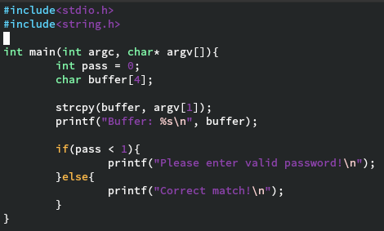
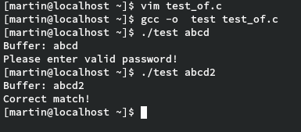
Flaws : Fingerd (stack overflow attack)
A utility used to obtain information about other users
Client-server based protocol : read single line of client’s input (gets()), then send back output matching the request
Security issue for gets() by buffer (stack) overflow attack
Vulnerable C functions : gets(), strcpy(), strcat(), etc << No boundary check
No guarantee that the size of argv[1] is <= 4
What if it causes the change the return address of stack?
Notes:
Fingerd : information such as the full name or login name of a user, whether or not a user is currently logged in, and possibly other information about the person such as telephone numbers where he or she can be reached.
‹#›

Slide 7
Flaws : Sendmail
A mailer designed to route mail in a heterogeneous internetwork
Use DEBUG command to execute a set of commands
Normally, it is not allowed, but DEBUG mode is often left turned on for convenience
Victim Host
Mailer
Sendmail
daemon
WORM
Dialog for
mail delivery
DEBUG
Scripts to run
SMTP
Notes:
Sendmail is a general purpose internetwork email routing facility that supports many kinds of mail-transfer and delivery methods, including the Simple Mail Transfer Protocol (SMTP) used for email transport over the Internet.
‹#›

Slide 8
Flaws : Passwords
(Old version of Unix) Breaking password is comparably possible!
/etc/passwd is readable with encrypted password string
Password cracking by comparing the encrypted possible words with /etc/passwd file
(Recent version of Unix/Linux)
/etc/passwd is still readable but the encrypted password is in /etc/shadow
Privileged rights is required to access /etc/shadow

Slide 9
Flaws : Trusted relationship
The relationship to allow access without password (/etc/hosts.equiv, ~/.rhosts)
”r” commands : rlogin, rsh, rcp, etc
Exploit reciprocal trust (A trusts B, B trusts A) by examining the files (hosts.equiv, .rhosts)
Ways to avoid the flaw
Not use the trust relationship
Use SSO (Single Sign On) like Kerberos

Slide 10
WORM structure
Main program
1) Collect information for potential victims
2) Use the flaws to establish its bootstrap on each of potential victims
Bootstrap/Vector
3) 99 lines of C code (can be compiled and executed locally)
4) Download main program binaries and load / link the binaries with the local standard libraries
Go to 1)

Slide 11
Detailed process Step 1 : starting
A socket is established for the vector program
Victim
Attacker
socket
main

Slide 12
Step 2 : Installing the vector program
Method a
TCP connection to a shell (rsh or Finger)
Method b
SMTP connection (sendmail)
Victim
Attacker
socket
main
Finger
rsh
Sendmail
Notes:
Via rsh or finger
‹#›

Slide 13
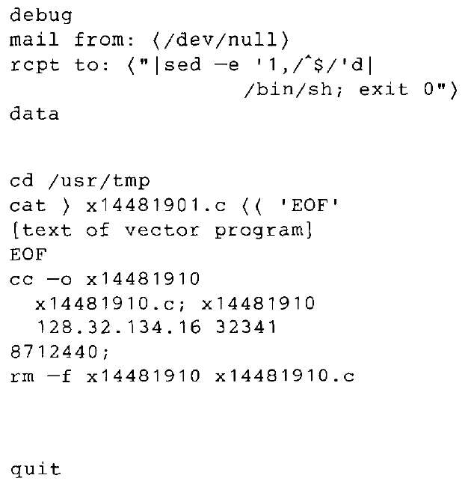
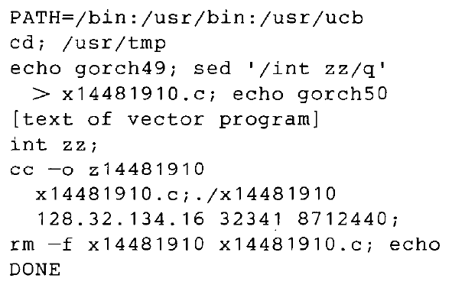
Step 2 : Installing the vector program (2)
Method a
TCP connection to a shell (rsh or Finger)
Method b
SMTP connection (sendmail)
Notes:
Via rsh or finger
‹#›

Slide 14
Step 3 : Downloading files from the server
The vector program downloads three files from the server worm
Sun 3 binary version worm
VAX version worm
Vector program source code
The vector became a shell (via execl call) with input/output by the server worm
Victim
Attacker
socket
main
Download files
vector
Shell
Notes:
Via rsh or finger
‹#›

Slide 15
Step 4 : Loading executables (“new worm”)
Server worm makes executables with the binaries via the connected shell (i.e, vector)
Executes the binaries (“new worm”)
Victim
Attacker
socket
main
Download files
vector
New worm main
Shell
Notes:
Via rsh or finger
‹#›

Slide 16
Step 5 : Hiding itself
(New worm) Hiding process to prevent detection
Remove all the trails it made (unlinking itself, killing its parent, encrypting each file, deleting from disk, etc)
Victim
Attacker
socket
main
Download files
vector
New worm main
Shell
Notes:
Via rsh or finger
‹#›

Slide 17
Step 6 : Gathering information
Gathering information through system calls (ioctl) and utilities (netstat) with various arguments:
Network interfaces
Reachable hosts
Victim
ioctl
New worm main
netstat
Notes:
Via rsh or finger
‹#›

Slide 18
Step 7 : Checking the reachability of potential victim
Use telnet or rexec ports to check the reachability
Victim
Reachability check
New worm main
Host
information
telnet or rexec
Notes:
Via rsh or finger
‹#›

Slide 19
Step 8 : Attempting the infection
Attack via rsh
Attempts to spawn a remote shell
If successful, go to 1 or 2(a)
Notes:
Via rsh or finger
‹#›

Slide 20
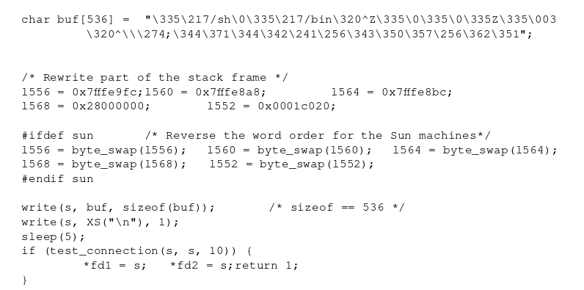
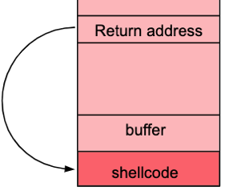
Step 8 : Attempting the infection
Attack via finger daemon
Finger has a 512 byte buffer on the stack
The worm calls write() with 536 char + newline argument
6 words overwrite system stack including return PC (Buffer overflow)
Resulted in system call version of execve(“/bin/sh”) that installed the worm on target system
Worked on VAX but not Suns systems

Slide 21
Step 8 : Attempting the infection
Attempt via sendmail: DEBUG mode
If reverse shell failed, the worm attempt to exploit the SMTP port
Then mailed an infection as already described in 2(b)

Slide 22
Step 9 : Cracking password
1) User Information gathering:
read through /etc/hosts.equiv & /.rhosts files to find names of equivalent hosts.
read /etc/passwd file
2) Cracking password (no password, then, simple combination)
3) Cracking password with internal dictionary
4) Cracking password with UNIX online dictionary
5) Loop forever, infecting hosts in internal tables and marked as not yet infected
Get back to 7 if it fails
Notes:
Via rsh or finger
‹#›

Slide 23
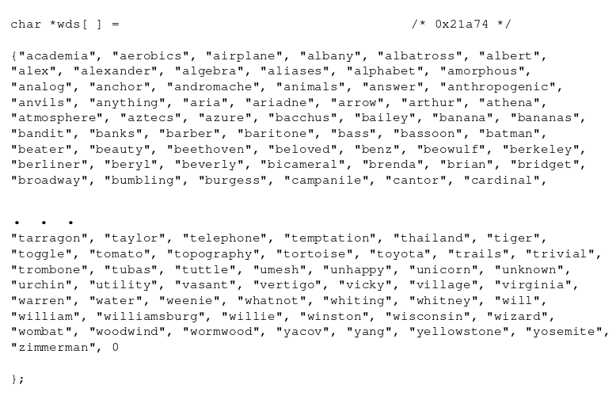
Worm Internal Dictionary Sample

Slide 24
Step 10 : Preparing the attack of other hosts with available information
Once a password was broken for any account, the worm would attempt to break into remote machines where that user had accounts by scanning the .forward and .rhosts files of the user.
Attack methods:
Attempt to create a remote shell using rexec service
Vulnerability: Same login credentials for multiple machines
Try rsh command to the remote host through rexec to current host
This depended on the remote machine’s hosts.equiv file or the user’s .rhosts file that allowed remote connection without a password
Success in remote shell acquisition = attack and spread the worm usings steps 1 and 2(a)
Notes:
Via rsh or finger
‹#›

Slide 25
Self Concealing Methods
Rename self to sh, renown name for the Bourne shell
strcpy(argv[0], XS(“sh”));
Set core dump size to zero:
rl.rlim_cur = 0;
rl.rlim_max = 0;
If (setrlimit(RLIMIT_CORE, &rl));
Delete parent process and manipulate process id
User encryption

Slide 26
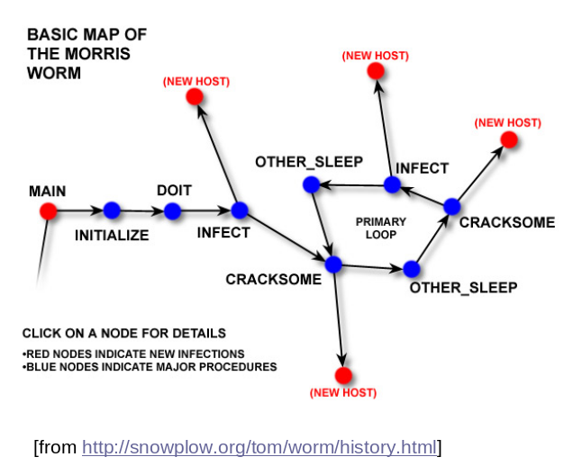
Worm Map

Slide 27
The worm was intended not to cause damages, however it did (was it a mistake?)
Some of infected machines became so loaded (with them worm) that they were unable to continue processing
Making a system heavily loaded with lots of worms
Self-destruction, but, there is a delay (perform by 9-c step then exit)
Possible immortal worm (1 out of every 7 worms)
Keeping the priority of worm for scheduling
fork() itself regularly and kill() its parent
Flushing its host list for every 12 hours (causing the same machine to be reinfected)
Notes:
Fork() and kill() : 1) change its PID (to avoid for single process to accumulate excessive amount of CPU time. 2) to keep its running priority (by new PID). -> did not always work correctly.
‹#›

Slide 28
Aftermath: Author, Intent, Punishment
Author:
Robert T. Morris, Professor at MIT
Convicted but he never confessed
Worm found on Cornell University computers in his account
Intent
Seemingly “no” damages done or intended
Only speculations:
Revenge on dad
Experiment gone wild
Planning something bigger
Punishment
3 years probation
400 hours of community service
$1050 plus cost of supervision

Slide 29
Worm Hunters
The worm was easily stopped almost solely due to UNIX “old-boy” network
Recommendations for establishment of a formal crisis center to deal with such crises.
Another attempt leveraging FTP flaw on MILNET.
Intruder was traced and MILNET/Arpanet links were severed.
Incident prompted for CERT (Computer Emergency Response Team) creation.
CERT acts as a central switchboard and coordinator for computer security emergencies on Arpanet & MILNET machines

Slide 30
Lessons from the worm incident
Factors that fueled its spread are the same that helped defeat it
Immediate communication
Ability to copy files, including binaries from machine to machine
Should communication be restricted in case of such attacks?
Most NRENs and network backbones have security teams prepared for such incidents

